Slide 6
3-1 Discrete Random Variables

Slide 7
3-1 Discrete Random Variables
Example 3-1

Slide 12
3-2 Probability Distributions and Probability Mass Functions
Figure 3-1 Probability distribution for bits in error.

Slide 13
3-2 Probability Distributions and Probability Mass Functions
Definition

Slide 14
3-3 Cumulative Distribution Functions
Definition

Slide 16
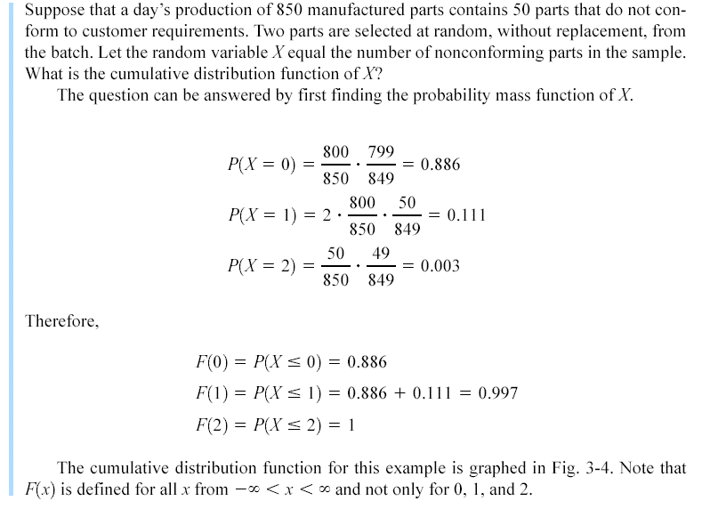
Example 3-8

Slide 17
Example 3-8
Figure 3-4 Cumulative distribution function for Example 3-8.

Slide 18
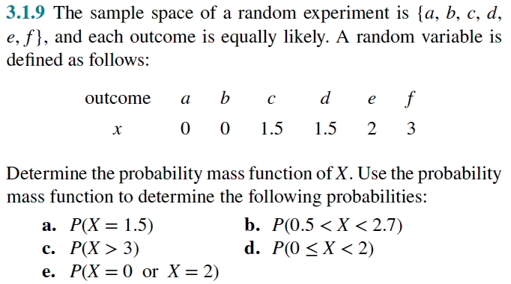

Slide 22
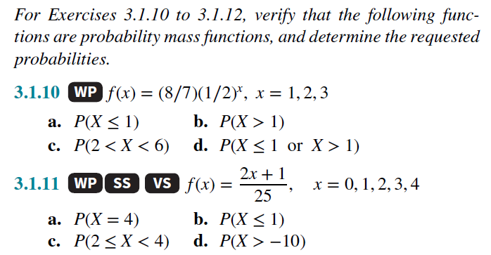

Slide 25
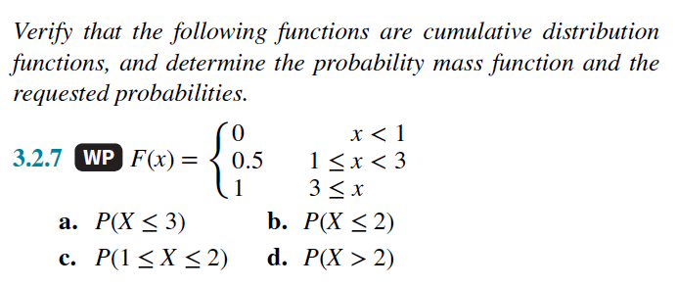

Slide 27
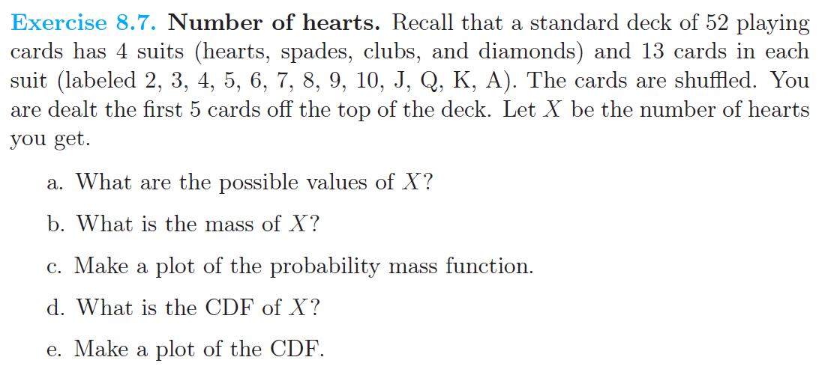

Slide 49
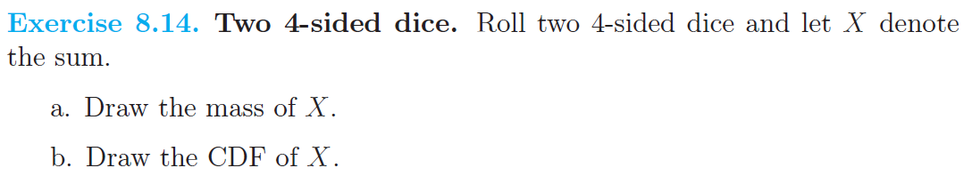

Slide 50
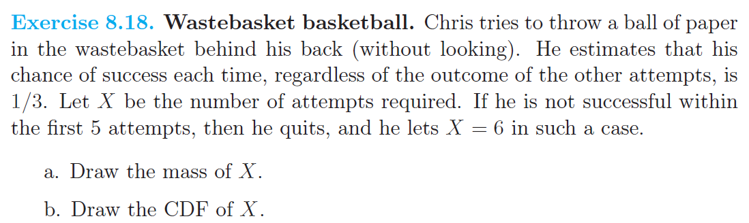

Slide 51
3-4 Mean and Variance of a Discrete Random Variable
Definition

Slide 52
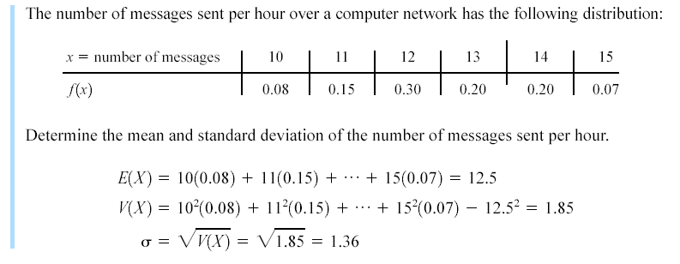
Example 3-11

Slide 53
3-4 Mean and Variance of a Discrete Random Variable
Expected Value of a Function of a Discrete Random Variable

Slide 56
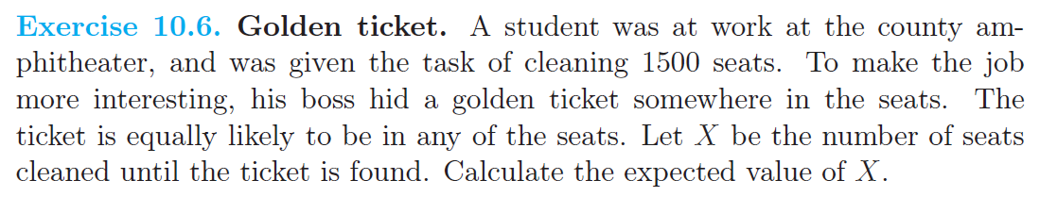

Slide 57
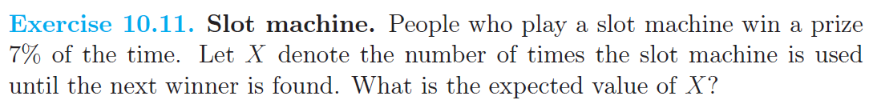

Slide 63
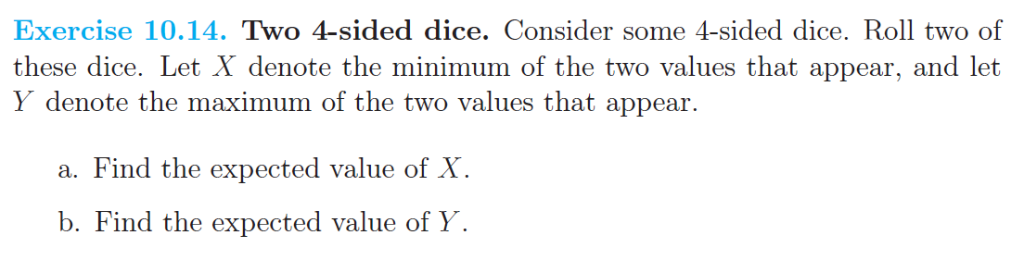

Slide 66
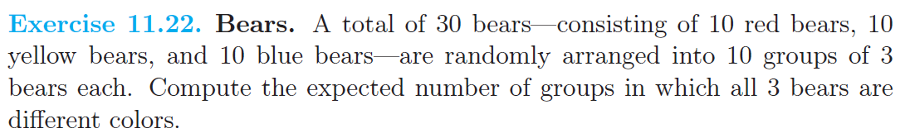

Slide 67
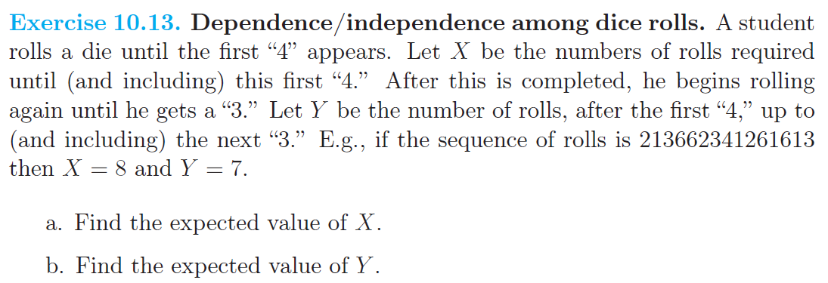

Slide 73
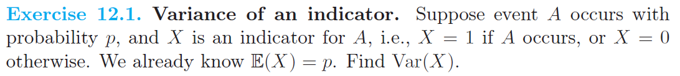

Slide 74
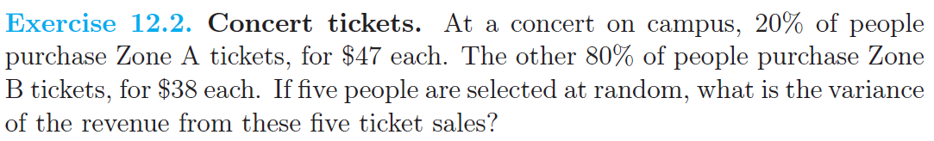

Slide 75
